Slide 1
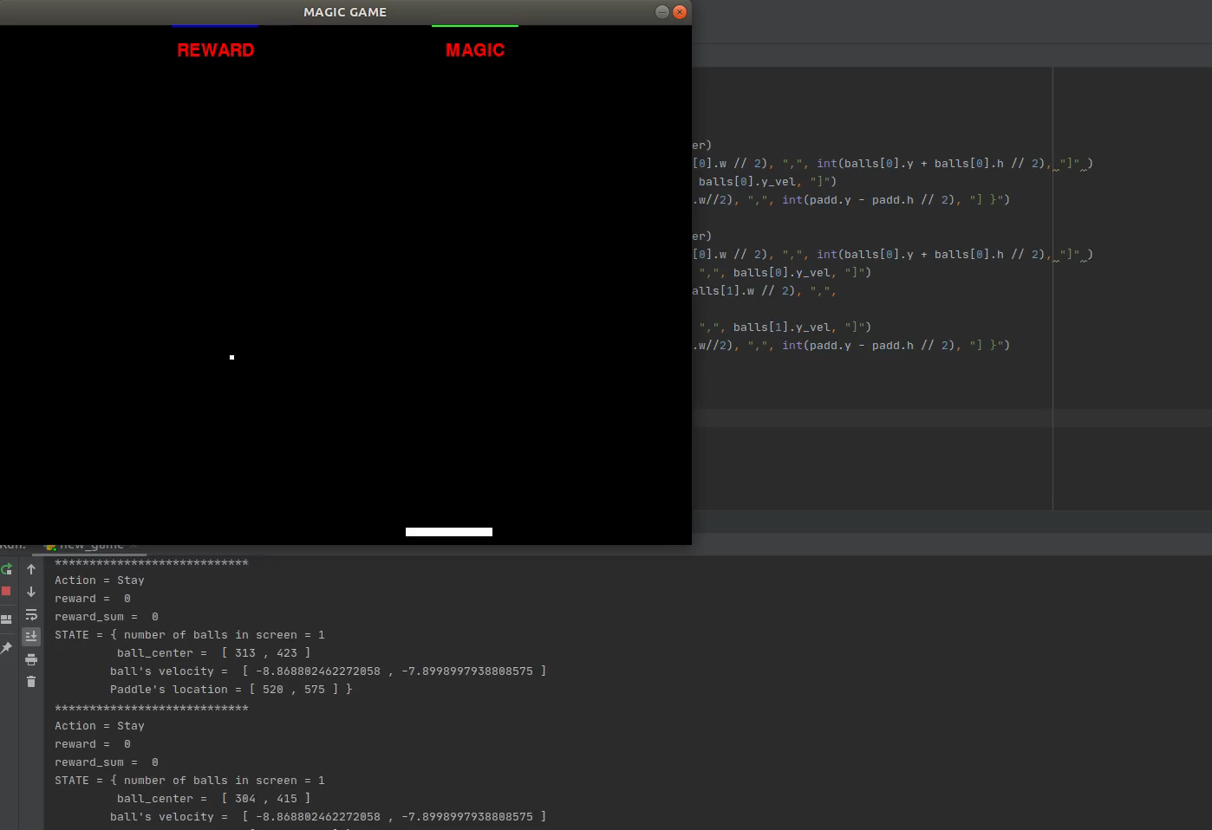
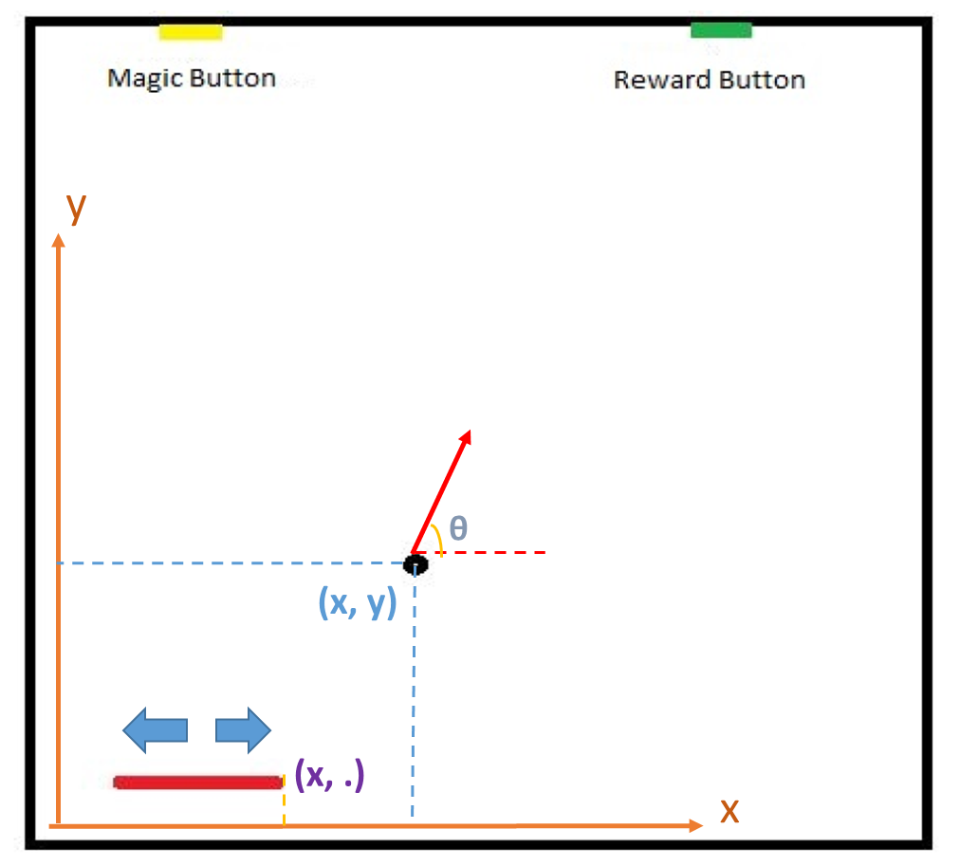
Game Description

Slide 2
Tuning
Reward Function:
-1 →each step
-|X_ball - X_paddle| → each step
Positive reward for hitting the paddle
Positive reward for wining
Negative reward for losing
Order:
3,5,7
Conclusion:
Adding Gamma, I, and using order 7
1000 for hitting the paddle, 10000 for wining, -1000 for losing

Slide 3
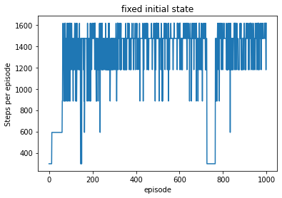
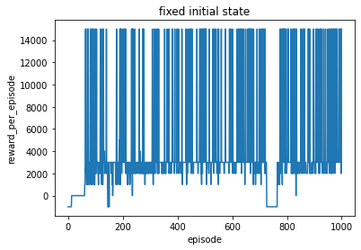
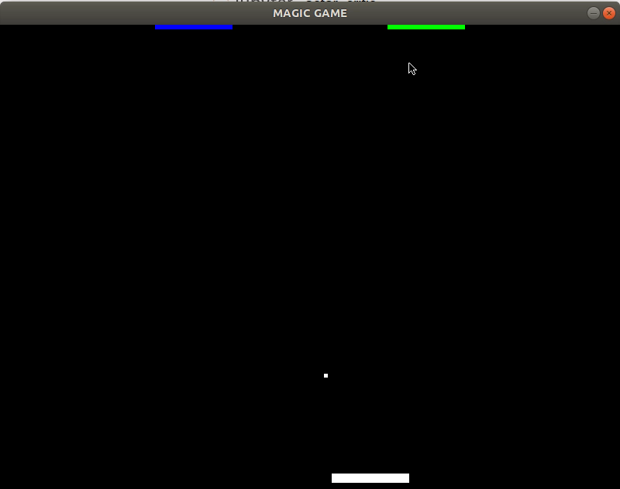
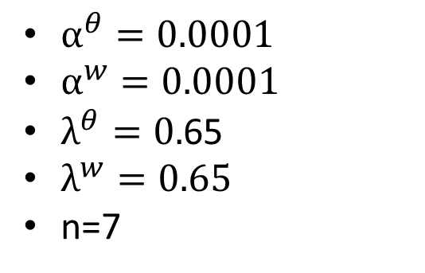
Simplest Version
$α^{θ}=0.0001$
$α^{w}=0.0001$
$λ^{θ}=0.$65
$λ^{w}=0.65$
n=7

Slide 4
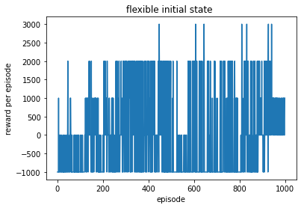
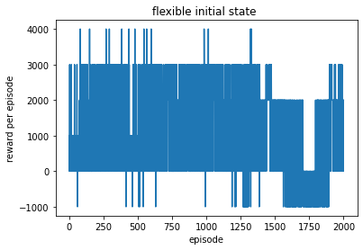
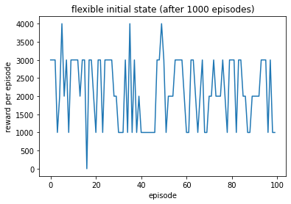
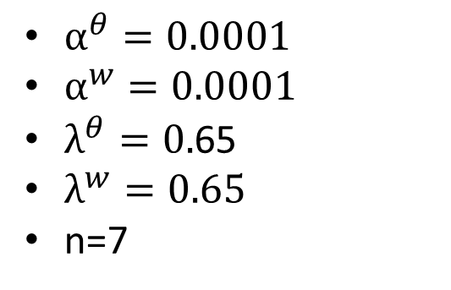
Simple Game with Three Initial Angles
$α^{θ}=0.0001$
$α^{w}=0.0001$
$λ^{θ}=0.$65
$λ^{w}=0.65$
n=7
Angles:
13π/32
14π/32
15π/32

Slide 5
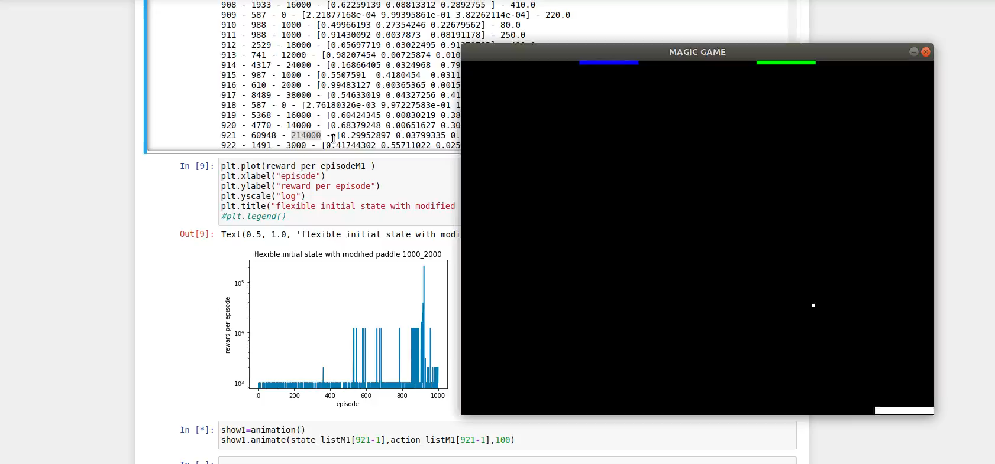
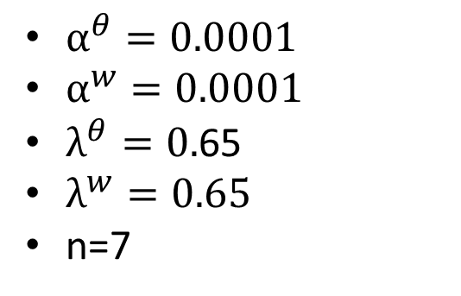
Multi-Functional Paddle
$α^{θ}=0.0001$
$α^{w}=0.0001$
$λ^{θ}=0.$65
$λ^{w}=0.65$
n=7
Angles:
13π/32
14π/32
15π/32

